Slide 1


Progress Meeting – Feb. 13, 2023
Past week
Coming week
Temperature & humidity integration with database
Sensor research
Further software dev.
Order required sensors
Test new flexure design
Software dev.
Integration of flexure with motor
Final report draft

Slide 2
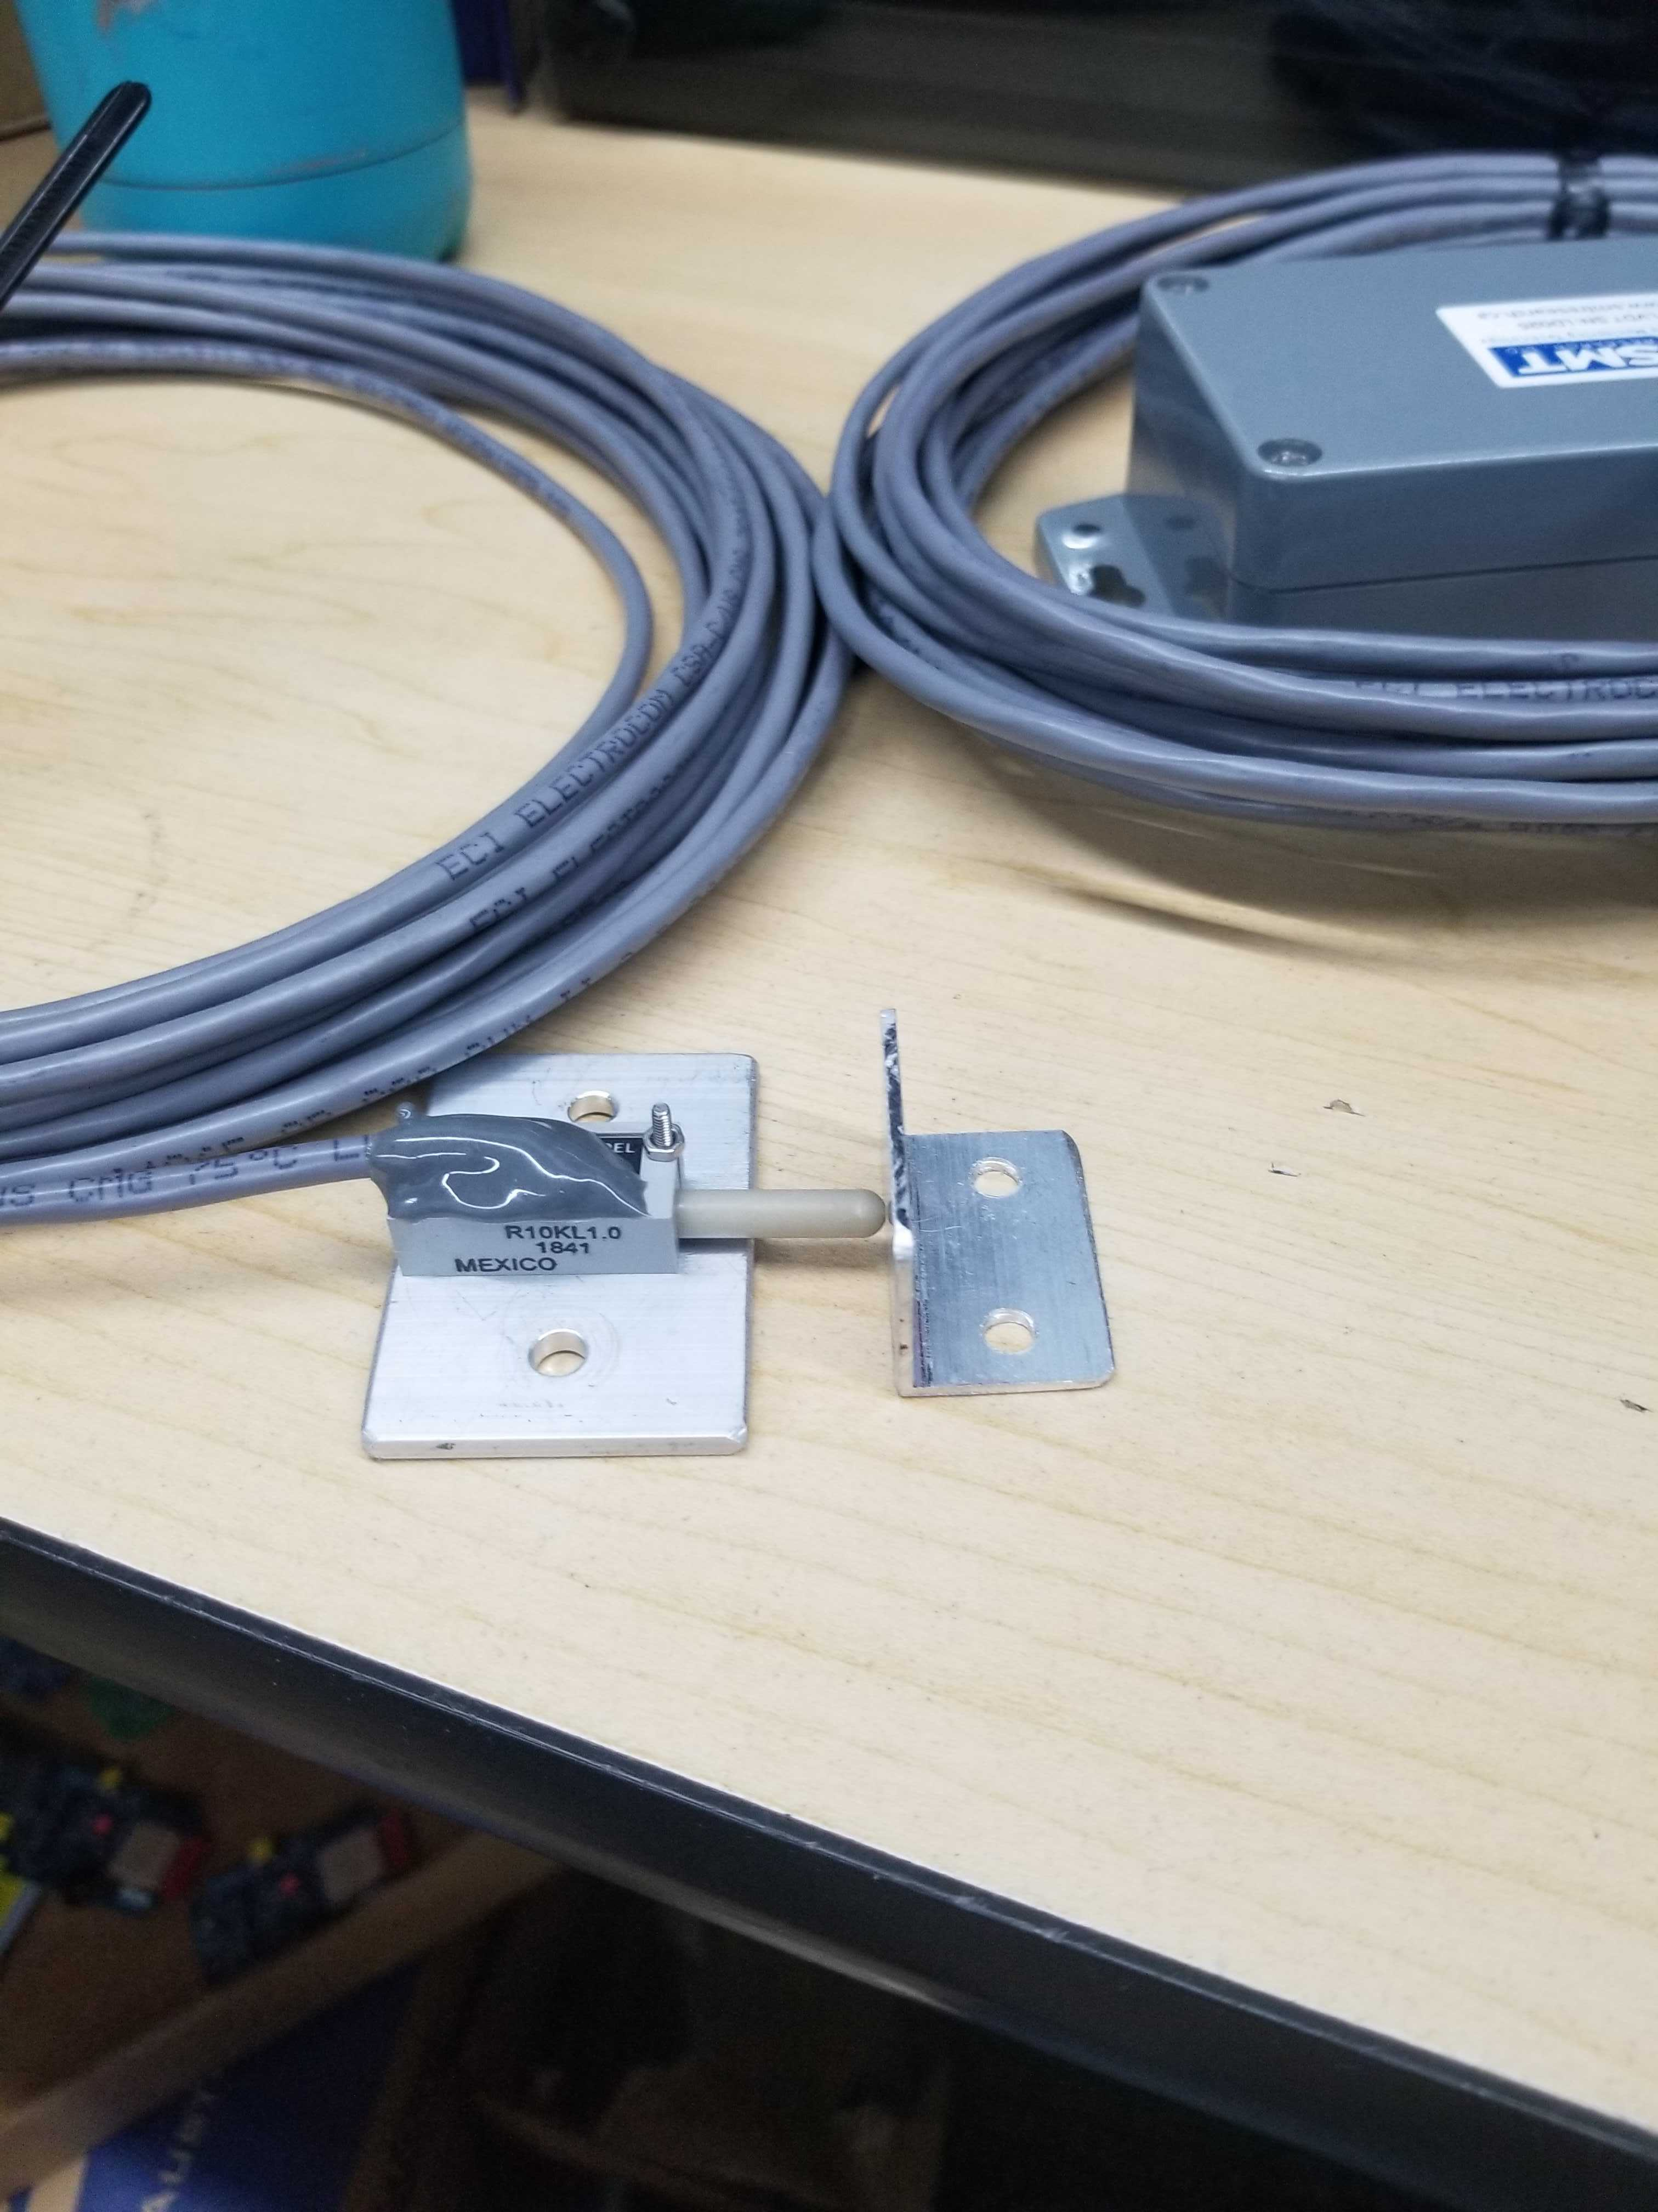
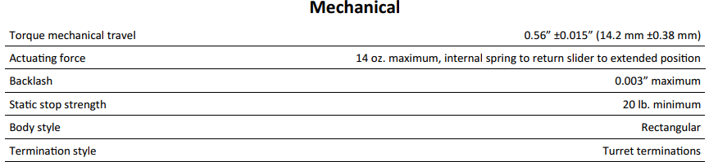
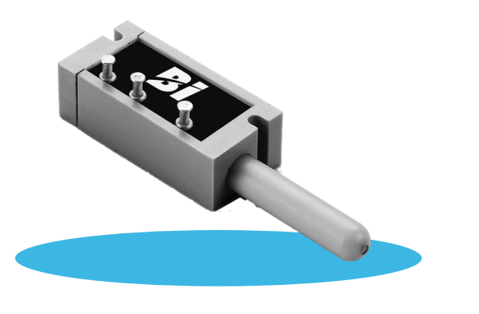
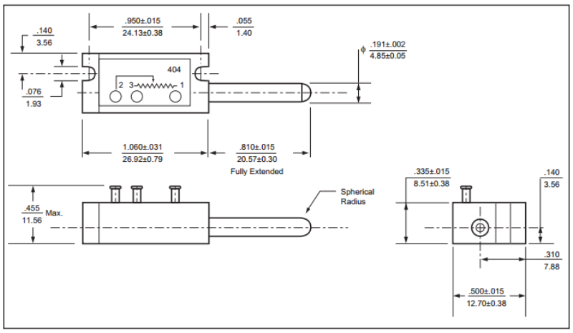
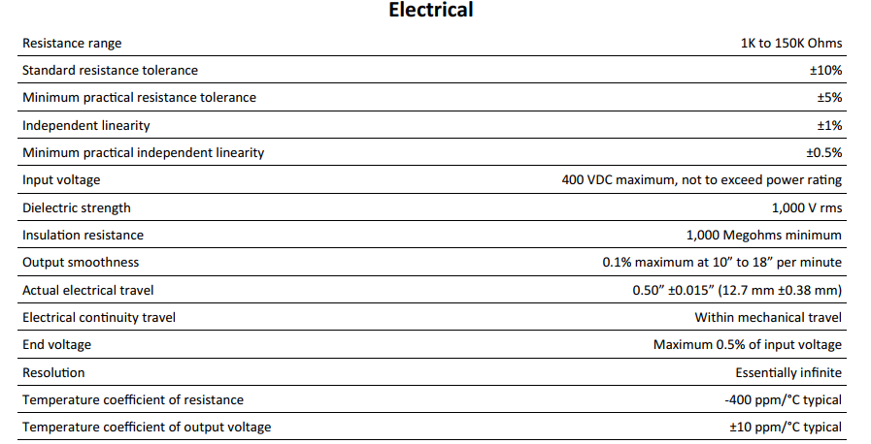
Model 404 Position Sensor

Slide 3

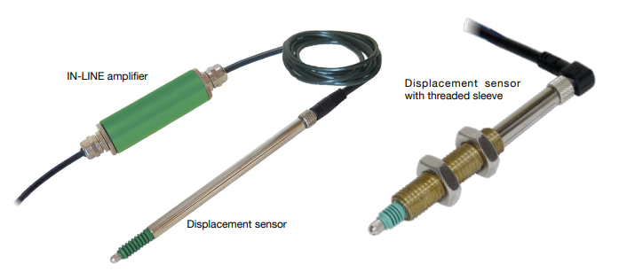
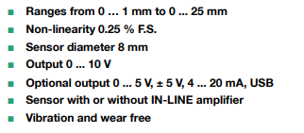

Slide 4
What has everyone been working on?
Meia Copeland
Talal Jaber
I2C connection for temperature/humidity sensor
Connection can be used for other variables later
Debugging motor issues
Shawaiz Khan
Ranishka Fernando
.db to .xlsx file conversion completed
Files sent as email attachments completed
Database to UI integration
Finalize research on linear displacement sensors and determine the required sensor.
Research on unguided core magnet displacement sensors
Marwan Zeyada
Database to UI integration

